Slide 1

The Inspector General Action Process (IGAP)
“First Be Correct – Then Take Action.”
Part Two

Slide 2
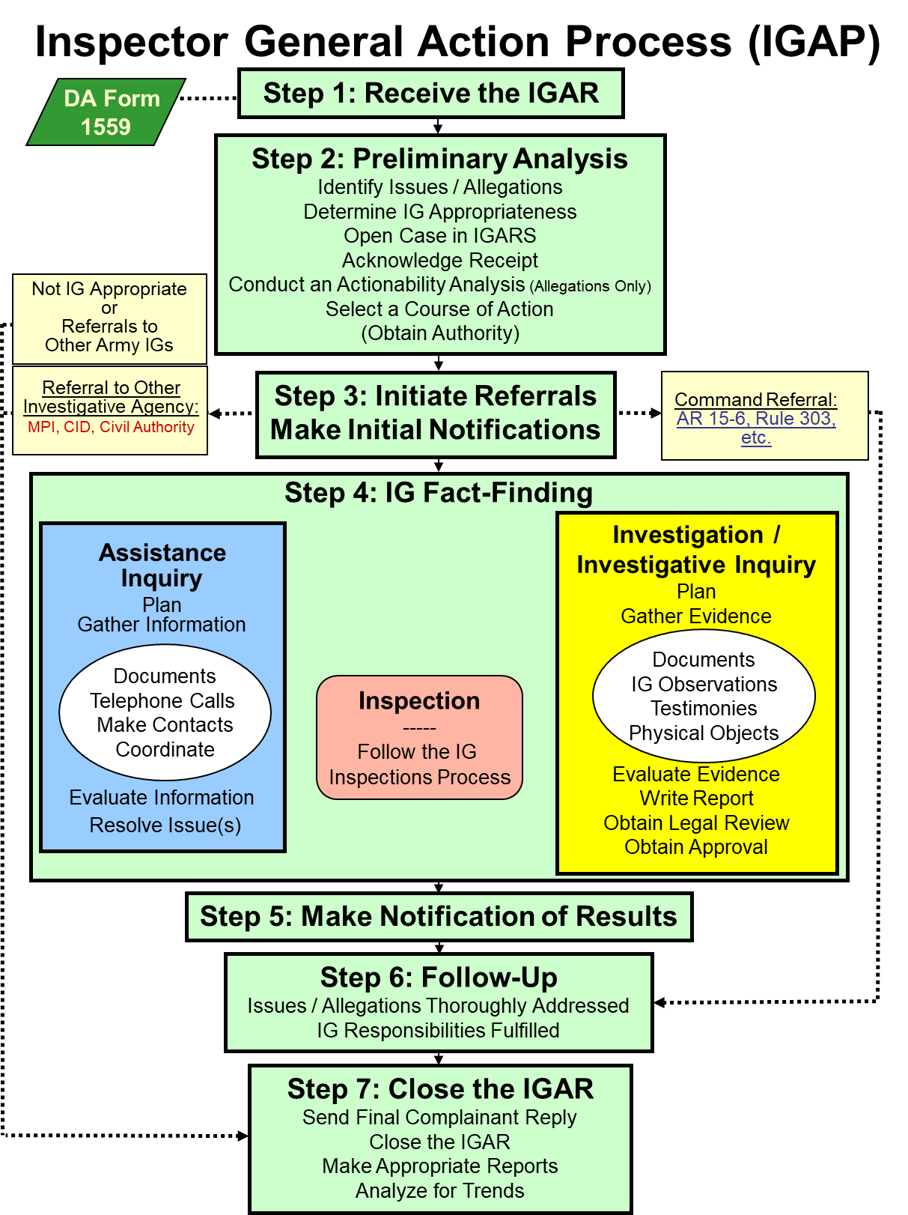
Inspector General Action Process (IGAP)
ELO
3
A&I Guide, Part One Sect. 2-1
AR 20-1, para. 6-1d

Slide 3
The Seven-Step IGAP
Step One
Step 1 Receive the IGAR
AR 20-1, para. 6-1d (1)
A&I Guide, Part One, Sect. 2-2

Slide 4
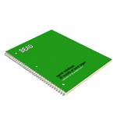
STEP 1: Receive the IGAR
IGARs come from the in crowd:
  Walk-in
  Call-in
  Write-in
  E-mail-in
  In the Gym …
A&I Guide, Part One, Sect. 2-2

Slide 5
STEP 1: Receive the IGAR
Getting Started
Private area
Put complainant at ease
Emotional Intelligence
Establish rapport but don’t buy in or be an advocate
Actively listen
Maintain control
Remember: Each story has at least sides:
three
  Complainant
  Other person
  Truth

Slide 6
STEP 1: Receive the IGAR
During the Interview
Ask for a timeline
Get details: full names, contact information
Ask for documents
Fundamental interview questions:
  1. What do you want the IG to do for you?
  2. Do you have any supporting documentation?
  3. Is the chain of command aware of this issue?
  4. Have you asked or contacted any other source or agency for assistance?
  5. What is your status?
A&I Guide, Part One, Sect. 2-2-1

Slide 7
STEP 1: Receive the IGAR
During the Interview
Complete the DA Form 1559
  Complainant OR
  IG can assist in drafting or complete it
Advise of Privacy Act
  Disclosure of DOD ID is voluntary
  unless needed to resolve issue
Read back and clarify;
ensure issues are understood
  Validate contact information
Obtain consent election
Have complainant sign if possible
Do I need to complete this form?

Slide 8
STEP 1: Receive the IGAR
Ending the Interview
Recap any due outs for either party
Do NOT commit/make promises
  “We will look into the matter”
  “We will provide a response”
  It’s ok to tell them when you will speak to them next
  Third Parties
Complainant may have a copy of the DA Form 1559
Return any original documents
A&I Guide, Part One, Sect. 2-2-1

Slide 9

STEP 1: Receive the IGAR
Call-Ins
Use the DA Form 1559 to:
  Review the Privacy Act
  Collect necessary information
  Read it back
  Ask about consent
Write “Telephonic” in Block 16: IG / Intake Remarks of the DA Form 1559
Ask for written follow-up (optional)
  Supporting documents
A&I Guide, Part One, Sect. 2-2-2

Slide 10
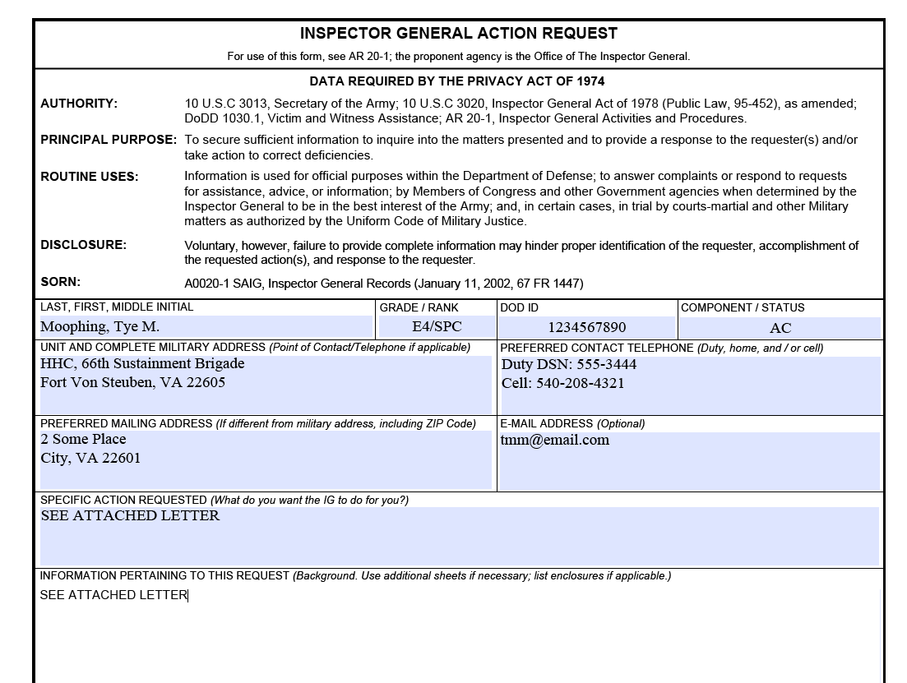
STEP 1: Receive the IGAR Write-In
No need to transfer information to DA Form 1559
See Attached Letter
A&I Guide, Part One, Sect. 2-2-3

Slide 11

STEP 1: Receive the IGAR
E-mail
Similar to a call-in
  Validate contact information
  Ask for phone number
Respond in a new message
Use a generic subject line:
  “Your E-mail”
    NOT “Your IG Complaint”
AR 20-1, para. 6-1f.(4)
A&I Guide, Part One, Sect. 2-2-4

Slide 12
STEP 1: Receive the IGAR Anonymous
Process like any other IGAR
Don’t try to figure out who it is
If the IG can establish what the issue or allegation is – likely enough information to work the case. However,
  Anonymity = non-consent to release of information
IGs can still ask questions
Substantiation rate for anonymous allegations is generally slightly higher than signed IGARs
AR 20-1, para. 6-2a
A&I Guide, Part One, Sect. 2-2-5

Slide 13
The Seven-Step IGAP
Step One
Step 1 Receive the IGAR
Questions?

Slide 14
The Seven-Step IGAP
Step Two
Step 2 Preliminary Analysis
Identify Issues / Allegations
Determine IG Appropriateness
Open Case in IGARS
Acknowledge Receipt
Conduct An Actionability Analysis (Allegations Only)
Select a Course of Action
(Obtain Authority)
AR 20-1, para. 6-1d (2)
A&I Guide, Part One, Sect. 2-3

Slide 15

STEP 2: Conduct IG Preliminary Analysis (PA)
A thought process to determine how best to proceed. May take minutes / hours / days.
Sub-Steps of Preliminary Analysis
  Identify issues / allegations
  Determine IG appropriateness
  Open the case in IGARS
  Acknowledge receipt
  Conduct an actionability analysis
  Select COA
AR 20-1, para. 6-1d (2)
A&I Guide, Part One, Sect. 2-3

Slide 16
STEP 2: IG PA
Identify Issues / Allegations
  Definitions:
  Issue:
  -- Complaint: expression of dissatisfaction or problem requiring assistance to resolve
  -- Information (RFI)
  -- Assistance: Request for help in working through or understanding a process or system
  Allegation: a complaint that lists who improperly did / did not do something in violation of a standard.
I see an issue.
And here is an
allegation!
A&I Guide, Part One, Sect. 2-3-1

Slide 17
STEP 2: IG PA
Identify Issues / Allegations
(continued)
Assistance Function focuses on resolving issues
IGs must take the time to correctly identify ALL of the issues and / or allegations
(explicit or implicit)
Analyze the complaint for:
  Broader issues
  Implied allegations
  Systemic problems
AR 20-1, para. 6-1d (2) (b)
A&I Guide, Part One, Sect. 2-3-1

Slide 18
STEP 2: IG PA
Determine IG Appropriateness
If the matter is Army related, you decide:
  What is appropriate for the local IG to work
  What is better handled by:
    Chain of command
    Other agencies
    Other IGs
Many matters raised to an IG may not be appropriate for the local IG to work.
AR 20-1, para. 6-3
A&I Guide, Part One, Sect. 2-3-2

Slide 19
STEP 2: IG PA
Determine IG Appropriateness
(continued)
Do not automatically categorize the whole IGAR as not IG appropriate
Example: “Someone broke the window on my car, took my iPhone and I can’t pay for it because I did not yet receive my travel pay from seven months ago.”
  Refer broken window to Military Police Investigations (MPI) for action
  IG will work the travel-pay issue
…. Is there a systemic issue?

Slide 20
STEP 2: IG PA
Determine IG Appropriateness
(continued)
If issue is not IG appropriate:
  Inform the complainant why it’s not appropriate
  Provide information for the appropriate office (contact info, specific requirements)
      Example: Army Board for Correction of Military Records (ABCMR) requires submissions on DD Form 149, Application for Correction of Military Record
  Conduct a Warm Hand-Off if possible
  Follow-up as required
More on this later…

Slide 21
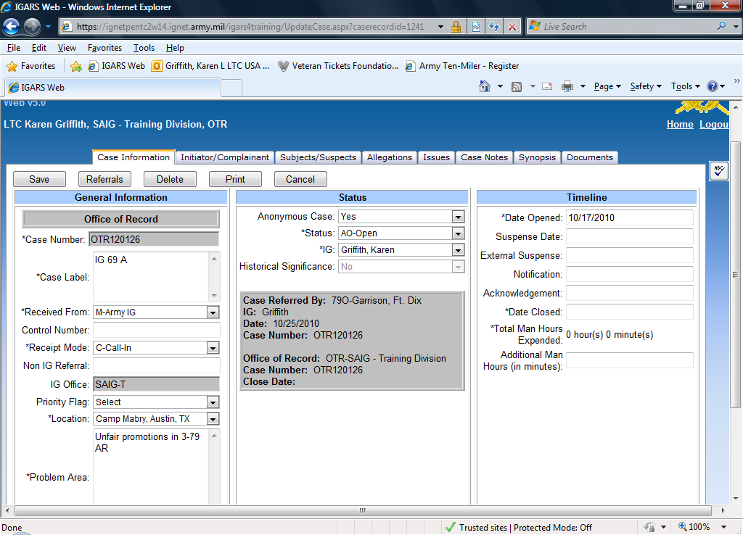
STEP 2: IG PA
Open the Case in IGARS
ALWAYS open case in the Inspector General Action Request System (IGARS)
  Authorized IG Record Repository
  Used by Army IGs
    world-wide
  Information IGAR
  Standard IGAR
  Case management
  and tracking
  IG-IG Referrals
  Historical Database
  Trends
AR 20-1, para. 6-1d (2) (j)
A&I Guide, Part One, Sect. 2-3-3

Slide 22
STEP 2: IG PA
Open the Case in IGARS
(continued)
Don’t sit on this…
Each case contains:
  Administrative information
  Issues/Allegations
  Case notes
  Synopsis
  Documents
Function codes describe each issue or allegation
  Be as specific as possible
  Accuracy makes the information useful and meaningful
AR 20-1, para. 6-1d (7)
A&I Guide, Part One, Sect. 2-3-3

Slide 23
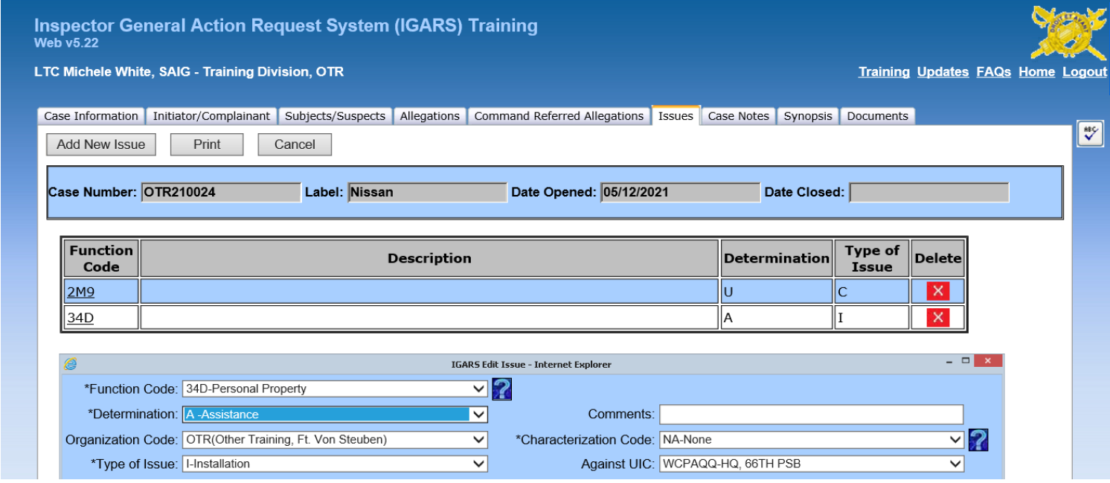
STEP 2: IG PA
Open the Case in IGARS
(continued)

Slide 24
STEP 2: IG PA
Acknowledge Receipt
Verbal or written
If the issue is IG appropriate:
  AND complainant has right to know, inform him or her that you will address the matter and provide a response
  BUT if the complainant is not directly affected: Send a third-party response thanking the individual for his or her concern and telling the person that you will look into the matter
AR 20-1, para. 6-1d (2) (a)
A&I Guide, Part One, Sect. 2-3-4 & 2-2-6

Slide 25
STEP 2: IG PA
Conduct an Actionability Analysis
The “Why”
Purpose:
To determine whether a complaint containing an allegation provides sufficient information to warrant IG or command investigatory action.
To ensure Commanders and IGs have the necessary information to conduct meaningful Investigative Inquiries / Investigations into whether a deed, displayed behavior, or unethical communication is in direct violation of an existing standard.
To determine the proper resolution path.
A&I Guide, Part Two, Sect. 2-10

Slide 26
STEP 2: IG PA
Conduct an Actionability Analysis
(Applicability)
Applies to locally received and referred cases that contain allegations, including complaints received from DAIG’s ASSIST-U
Does NOT apply to DoD Whistleblower Reprisal and Restriction cases or DoD Hotline Action Cases
A&I Guide, Part Two, Sect. 2-10

Slide 27


STEP 2: IG PA
Conduct an Actionability Analysis
The “What”
ELO 15
IG must complete at least one of these actions:
Conduct Complaint Clarification Interview (CCI)
Conduct Additional Interviews:
  Experts
  Witnesses
  No more than five
  Not the Subject/Suspect (the “who”)
Collect and Review Documents
A&I Guide, Part Two, Sect. 2-10

Slide 28
STEP 2: IG PA
Conduct an Actionability Analysis
The “How”
Is the allegation of impropriety connected directly to a named individual?
Is the complainant able to convey the alleged wrongdoing clearly enough for the IG to determine if a standard applies?
Did the IG evaluate documents provided by the complainant or obtained by IG authority that support the possibility that an impropriety occurred?
Does the complaint and supporting material provide enough information to conduct a thorough investigation?
Does the nature of the allegation suggest that only a minor infraction occurred? (Teaching and Training)
A&I Guide, Part Two, Sect. 2-10

Slide 29
STEP 2: IG PA
Conduct an Actionability Analysis
(continued)
Information gathered and analyzed in order to determine actionability
Facilitates the selection of the Course of Action
Is it Actionable?
NO
Administrative Closure Process
Evaluate and Close
YES
Proceed to
Step 3
Refer
Investigate
A&I Guide, Part Two, Sect. 2-10

Slide 30
STEP 2: IG PA
Select a Course of Action
Inspect
Assistance Inquiry
Evaluate and Close
Refer (Command; another Agency or IG office)
Investigate / Investigative Inquiry
A&I Guide, Part One, Sect. 2-3-6

Slide 31
STEP 2: IG PA
Selection of Course of Action
(continued)
IG INSPECTION:
Inspector General
Assistant IG
Focuses on systemic issues
Root Cause
Recommendation for corrections (taskers)
Directing Authority determines scope and content (Directive)
INSPECTIONS BLOCK

Slide 32
STEP 2: IG PA
Selection of Course of Action
(continued)
ASSISTANCE INQUIRY:
IGs, Assistant IGs, Temporary Assistant IGs and Acting IGs (with limits and oversight)
Resolve issues
Resolve requests for assistance
Answering requests for information
Not for allegations
An informal fact-finding process

Slide 33
STEP 2: IG PA
Selection of Course of Action
(continued)
Investigative Inquiry
Inspector General
Resolve Allegations
Informal fact-finding process
Investigation:
Inspector General
Resolve Allegations
Formal fact-finding process
INVESTIGATIONS BLOCK

Slide 34
STEP 2: IG PA
Selection of Course of Action
(continued)
Evaluate and Close:
Minor Infractions (AR 20-1 para 7-1.m.)
Not-Actionable Determinations
  Complaint Actionability Determination Worksheet
  O5/O6, GS14/15 CIG/SIG approved
The Actionability Determination
Administrative Closure Process
Administrative Closure – Proceed to Step 6
Complete Telephonic and Written Final Reply
Close IGARS case file with “E” code:
“Evaluate and Close”
CIG, DIG or
A&I
Not Actionable
SJA
Opine
Concur - Not Actionable
CIG
*AO Prepares
Closure
Packet
Peer
Review
Not Actionable
* This portion of the determination process begins only when AO determines allegation is not actionable
Non-Concur* - Actionable
Actionable
Actionable
Proceed to
Step 3
Proceed to
Step 3

Slide 35
STEP 2: IG PA
Selection of Course of Action
Evaluate and Close
(continued)
SJA annotates concurrence or non-concurrence on Complaint Actionability Determination Worksheet.
  Written analysis is not required.
If the SJA non-concurs, CIG may:
  Accept SJA opinion (proceed to Step 3).
  Move forward with the Administrative Closure Process.
    Discuss with SJA to gain better understanding; the goal is to be in agreement.
    Direct IGs to conduct additional analysis.

Slide 36

STEP 2: IG PA
Selection of Course of Action
(continued)
REFERRAL:
When the appropriate office to address the issue/allegation is:
1. Chain of Command (keep open and monitor)
2. Different IG Office (refer in IGARS, then close)
3. Different entity or organization: (5-day follow-up)
  Military Equal Opportunity
  Equal Employment Opportunity
  Criminal Investigations Division
  SARC
  ((Army Board for Correction of Military Records))

Slide 37
The Seven-Step IGAP
Step Two
Step 2 Preliminary Analysis
Identify Issues / Allegations
Determine IG Appropriateness
Open Case in IGARS
Acknowledge Receipt
Conduct An Actionability Analysis (Allegations Only)
Select a Course of Action
(Obtain Authority)
Questions?

Slide 38
The Seven-Step IGAP
Step Three
Step 3 Initiate Referrals Make Initial Notifications
AR 20-1, para. 6-1d (3)
A&I Guide, Part One, Sect. 2-4

Slide 39

STEP 3: Initiate Referrals & Make Initial Notifications
Matters best addressed by the chain of command
  Refer to the lowest level of commander with the authority to fix the issue
  Monitor the case to ensure the chain of command takes proper action
    Review the command product
  Then close the case
A&I Guide, Part One, Sect. 2-4-1

Slide 40

STEP 3: Initiate Referrals & Make Initial Notifications
(continued)
Matters that are not IG appropriate:
  Refer to the proper agency (Veterans Affairs, Chaplain, etc.)
    Warm Hand-off
  Follow-up with the complainant within five days
  Close the case
Matters that are not LOCAL IG appropriate:
  IG Tech Channel (warm hand-off)
  Refer to the appropriate IG office (IGARS)
    SAIG-IN for Senior Official Allegations
    Sphere of activity
  Close the case
A&I Guide, Part One, Sect. 2-4-1

Slide 41
STEP 3: Initiate Referrals & Make Initial Notifications
(continued)
No Initial Notifications for Assistance Cases
For allegations, initial notifications are required for subject / suspect and supervisor / commander
Wait for the Investigations block of instruction to hear all about it!
AR 20-1, para. 7-1b (3)
A&I Guide, Part One, Sect. 2-4-2

Slide 42
The Seven-Step IGAP
Step Three
Step 3 Initiate Referrals Make Initial Notifications
Questions?

Slide 43
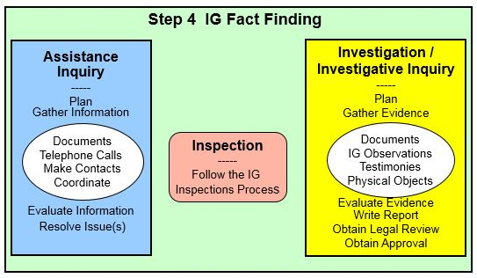
The Seven-Step IGAP
Step Four
Assistance
Inquiry
Plan
Gather Information
Evaluate Information
Resolve Issue(s)
Documents
Telephone Calls
Make Contacts
Coordinate
A&I Guide, Part One, Sect. 2-5

Slide 44
STEP 4: IG Fact-Finding
Assistance Inquiry
Authority to conduct “Fact-Finding” for:
  Inspection: Directive from the Directing Authority
  Investigation: Directive from the Directing Authority
  Assistance: No permission needed
  Informal process to obtain facts/information that will support an IG’s decision
  To address or resolve issues
  Access to all Dept. of the Army records
AR 20-1, para. 1-8a
A&I Guide, Part One, Sect. 2-5

Slide 45
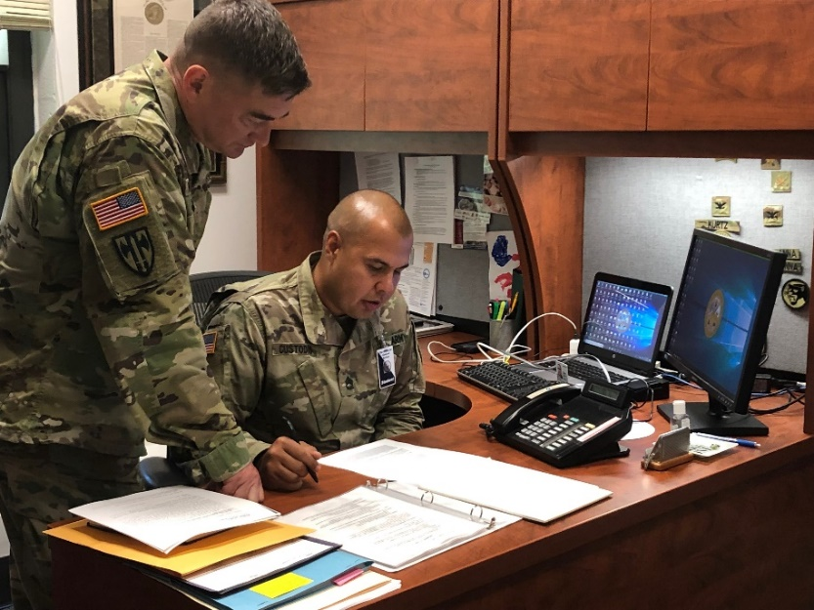
STEP 4: IG Fact-Finding
Assistance Inquiry
(continued)
Plan
Gather Information
  Documents – Timeline
  Processes, Policies, Regulations
  Make Contacts: Subject Matter Experts, Staff, Leaders
    Telephone Calls / MS Teams
    Emails
    Get out of your seat (In-person)
    Observations
  Coordinate:
    Who, What, When, How
Evaluate Information
Resolve Issue(s) – What’s the road-block
Confidentiality
A&I Guide, Part One, Sect. 2-5

Slide 46
The Seven-Step IGAP
Step Four
Assistance
Inquiry
Plan
Gather Information
Evaluate Information
Resolve Issue(s)
Documents
Telephone Calls
Make Contacts
Coordinate
Questions?

Slide 47
The Seven-Step IGAP
Step Five
Step 5 Make Notification of Results
AR 20-1, para. 6-1d (5)
A&I Guide, Part One, Sect. 2-6

Slide 48
STEP 5: Make Notification of Results
Informing complainant of results (SITREP)
  Update on the status, may not be final resolution
  Due outs or required actions
Provide only information pertaining directly to the complainant, verbally or in writing
Remember third-party rules
Notifications are included in case notes in IGARS
AR 20-1, 6-1d (5)
A&I Guide Part One, Sect. 2-6

Slide 49
The Seven-Step IGAP
Step Five
Step 5 Make Notification of Results
Questions?

Slide 50
The Seven-Step IGAP
Step Six
Step 6 Follow-Up
Issues / Allegations Thoroughly Addressed
IG Responsibilities Fulfilled
AR 20-1, para. 6-1d (6)
A&I Guide, Part One, Sect. 2-7

Slide 51

STEP 6: Follow-up
IG can contact complainant or the complainant can contact the IG
  Ensure issues were thoroughly
  addressed
Peer review, Checklist, Tech Channel
  Ensure all IG responsibilities are
  fulfilled
AR 20-1, para. 6-1d (6)
A&I Guide, Part One, Sect. 2-7

Slide 52
The Seven-Step IGAP
Step Six
Step 6 Follow-Up
Issues / Allegations Thoroughly Addressed
IG Responsibilities Fulfilled
Questions?

Slide 53
The Seven-Step IGAP
Step Seven
Step 7 Close the IGAR
Send Final Reply
Close the IGAR
Make Appropriate Reports
Analyze for Trends
AR 20-1, para. 6-1d (7)
A&I Guide, Part One, Sect. 2-8

Slide 54
STEP 7: Close the IGAR
Provide complainant a final reply
Close the case in the IGARS database
Make appropriate reports
Analyze for developing trends
AR 20-1, para. 6-1d (7)
A&I Guide, Part One ,Sect. 2-8

Slide 55
STEP 7: Close the IGAR
Final Reply to Complainant
Written response to the complainant:
  Address the complaint
  Summarize the facts and conclusions that pertain to the complainant
  Maintain confidentiality
Annotate in IGARS case notes
Dear COL Saunders,
This responds to
your January 25, 2023
letter to the IG . . .
Excellent opportunity to Teach and Train
A&I Guide, Part One, Sect. 2-8-1

Slide 56
STEP 7: Close the IGAR
Final Reply to Complainant
(continued)
Replies normally will not contain:
  Classified information
  Information / documents from outside agencies without their permission
  Identity of sources or techniques used
  All information surfaced
  Results of disciplinary action
  Information that violates privacy of others

Slide 57
STEP 7: Close the IGAR
Final Reply to Complainant
(continued)
If complainant is not satisfied with response:
  Re-examine inquiry and response for completeness
  Refer to next higher IG
  Don’t take it personally!!
AR 20-1, para. 6-1d (7) (d)

Slide 58
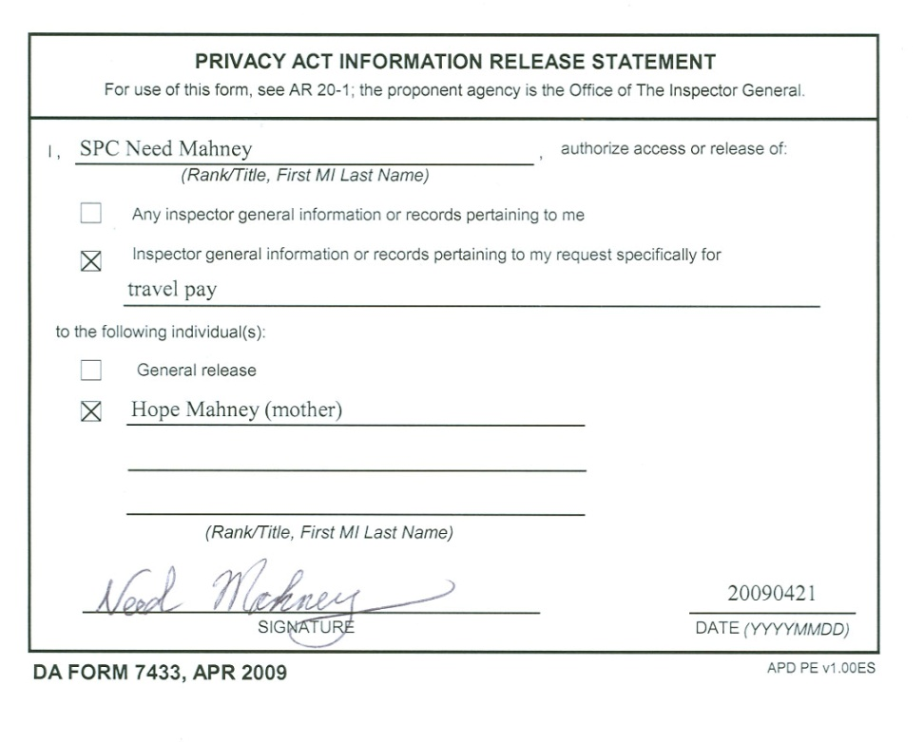
STEP 7: Close the IGAR
Final Reply to Complainant
(continued)
ELO
4
Third-party complaint
  No right to know results if the issues do not directly pertain to complainant
  The IG must have a
  DA Form 7433 signed by
  the first party
  before releasing inquiry
  results to a third party

Slide 59


STEP 7: Close the IGAR
Final Reply to Complainant
Not-Actionable Determinations
  Final replies are both telephonic and in writing
  Final response is detailed with determination rationale
  Avoid judgmental terminology such as “lacked merit” or “lacked credibility”
If complainant provides new information:
  - Analyze the new information.
If complainant requests reconsideration:
  Not a proactive offer
  Complainant must submit a written request to DAIG within 30 days with new information / supporting evidence
  The IG provides DAIG contact information: USARMYDAIGassistance@army.mil
A&I Guide, Part Two, Section 2-10
U.S. Army Inspector General School
Notes:
Telephonically notify of results and explain rationale.

Slide 60
STEP 7: Close the IGAR
Close the Case in IGARS
Determination Codes: A, F, U, S, N, CS, CN
  A - Assistance.
  Use the determination “assistance” when the IG provided advice, offered guidance, or resolved the request for assistance(C.I.A.)
  Referral to an agency other than the IG to resolve the problem. For example, an allegation that the IG refers to CID or MEO.
ISSUES
A&I Guide, Part One, Sect. 2-8-2

Slide 61
STEP 7: Close the IGAR
Close the Case in IGARS
(continued)
Determination Codes: A, F, U, S, N, CS, CN
  F - Founded.
  Use the determination “founded” when the complaint has merit and required resolution.
  U - Unfounded.
  Use the determination “unfounded” when the complaint does not have merit and there was no evidence that a problem existed for the IG to resolve.
ISSUES
A&I Guide, Part One, Sect. 2-8-2

Slide 62
STEP 7: Close the IGAR:
Close the Case in IGARS
(continued)

Slide 63
STEP 7: Close the IGAR
Close the Case in IGARS
(continued)
Determination Codes: A, F, U, S, N, E, CS, CN
  S - Substantiated. Use the determination “substantiated” when it is more likely than not (preponderance of evidence) that the standard WAS violated.
  N - NOT Substantiated. Use the determination “not substantiated” when it is more likely than not (preponderance of evidence) that the standard was NOT violated.
  E – Evaluate and Close. Use the determination “evaluate and close” when there is insufficient information to warrant IG/Command investigatory action or for a minor infraction – As determined by CIG
ALLEGATIONS
A&I Guide, Part One, Sect. 2-8-2

Slide 64
STEP 7: Close the IGAR
Close the Case in IGARS
(continued)
Determination Codes: A, F, U, S, N, E, CS, CN
  CS - Command Substantiated. Use the determination code “CS” when the command product of command referred allegation(s) indicates that the violation occurred.
  CN - Command Not Substantiated. Use the determination code “CN” when the command product of command referred allegation(s) indicates that the violation did not occur.
ALLEGATIONS
A&I Guide, Part One, Sect. 2-8-2

Slide 65
STEP 7: Close the IGAR
Close the Case in IGARS
(continued)
Finish Case notes:
A chronological listing of a case history used to identify fully the complainant, the allegations, issues, or assistance requested; the actions taken in resolving the case (POCs, phone numbers, notifications, etc.); and the final outcome.
Each entry begins with the date and the action officer’s name
A&I Guide Part One, Sect. 2-3-3

Slide 66
Example of Case Notes
Step 5:
5/13/2021 (LTC Michele White): I contacted the complainant and provided an update about the status of her HHGs. I asked SPC Nissan to contact this office upon receipt of her HHGs
Step 6:
5/19/2021 (LTC Michele White): I received telephonic confirmation from SPC Nissan that she received her HHGs. When asked, SPC Nissan said she felt that her complaint was resolved and she required no further assistance from the IG.
Step 7:
5/20/2021 (LTC Michele White): I prepared and emailed a final response to the complainant to the preferred email address listed: toni@email.com
5/21/2021 (LTC Michele White): I finalized the case notes, completed the synopsis, conducted a peer review with LTC Sisak. CIG approved to close this case in IGARS.

Slide 67
STEP 7: Close the IGAR
Close the Case in IGARS
(continued)
Complete the Synopsis:
  “Executive Summary”
  Stand-alone document
  Who, what, when, where, and how
  Four Part format / template
  Final Determination
A&I Guide, Part One, Sect. 2-8-2

Slide 68
STEP 7: Close the IGAR
Make Appropriate Reports
These reports are covered in your local Standing Operating Procedures (SOP)
AR 20-1, para. 6-1d (7)
A&I Guide, Part One, Sect. 2-8-3

Slide 69
STEP 7: Close the IGAR
Analyze for Trends
Ensure all IGs are coding similar cases with same function codes
Trends
  Look for both positive and negative trends
  Seasonal trends
  Organizational trends
Systemic issues
  Office workload
  Source of IGARs
  Most frequent function codes
  Most substantiated function codes
A&I Guide, Part One, Sect. 2-8-4

Slide 70
The Seven-Step IGAP
Step Seven
Step 7 Close the IGAR
Send Final Reply
Close the IGAR
Make Appropriate Reports
Analyze for Trends
Questions?

Slide 71
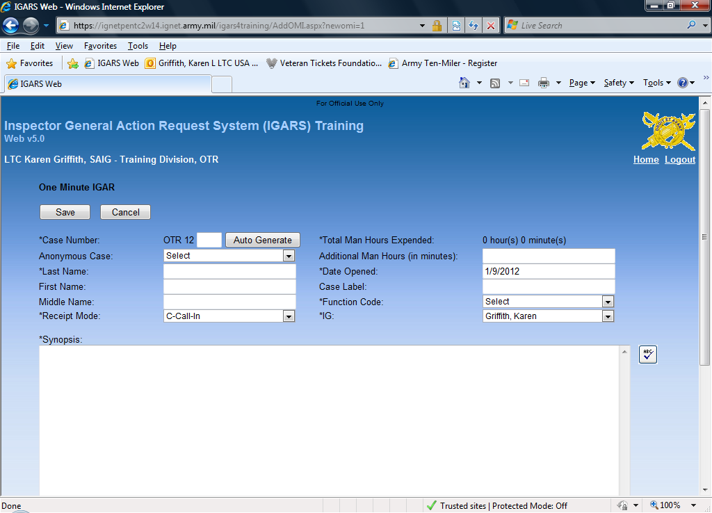
Information IGAR
What if a complainant has a simple request for information that the IG can easily resolve?
Requests for Information and IG-to-IG Support
IG Staff Coordination, IG led Training, SAVs
Due Process Review
Inspections
Opened / Closed on same day
Cannot be converted to a Standard IGAR
If the issue has an associated
Function code, use a Standard IGAR
Capture your Time
Not good for Trends
A&I Guide, Part One, Sect. 2-3-3 & 2-8-2

Slide 72
Inspector General Action Process (IGAP)
ELO
3
A&I Guide, Parts One and Two, Chapter 2; AR 20-1, para. 6-1

Slide 73
Check on Learning
Is it important to know a complainant’s identity in order to resolve a case?
NO
What step includes the actionability analysis and when is it applied?
Step 2, (sub-step 5) IGPA; for Allegations only
What steps will the IG always do?
Steps 1 and 2: Receive the IGAR and Conduct Preliminary Analysis (PA)

